Slide 1
Methodological and practical issues in rankings of regions
Andrzej Sokołowski, Małgorzata Markowska

Slide 2
The aim of the presentation
To share our practical experience and theoretical studies gained in the process of building rankings of regions.

Slide 3
Why?
Classification of European regional space in the perspective of intelligent development concept – dynamic perspective (2011/01/B/HS4/04743)
Smart growth and economic crisis in the European regional space - methods of measurement (2013/09/B/HS4/00509)
Smart growth and sectoral transformations in the European regional space (2015/17/B/HS4/01021)
Selected Problems in Multivariate Analysis – Grant from the Faculty of Management at Cracow University of Economics within the framework of the subsidy for the maintanance of research potential (2012-2018)

Slide 4
Taxonomic Tasks
Ordering / Rankings
Clustering / Grouping
Identification / Classification

Slide 5
Taxonomic Problems
Y – objects
Z – variables
T – time units
[OTUs, Classification space]

Slide 6
1. Proper Definition of Taxonomic Problem
Most popular: [Y,Zt]
Dynamic ordering [YT,Z]
Grabiński T. (1975), Dynamiczne modele analizy taksonomicznej, Akademia Ekonomiczna, Kraków, PhD thesis
Sokołowski A. (1982), O zagadnieniach taksonomicznych, Zeszyty Naukowe Akademii Ekonomicznej w Krakowie nr 165, 65–71.
Markowska M. (2012), Dynamiczna taksonomia innowacyjności regionów, Wyd. Uniwersytetu Ekonomicznego we Wrocławiu, Monografie i Opracowania 221, Wrocław.

Slide 7
2. General and sub-criteria
General criterion examples: Quality of Life, Smart Development, Sustainable Growth, Innovativeness of Regions, Competitiveness of Regions, University Quality, …
Sub-criteria – „What does it (general criterion) mean?”

Slide 8
3. Initial list of diagnostic variables
The theory of the problem (general criterion)
The first and crucial condition for variables: availability
Acceptable data quality
What shall we do with qualitative variables?

Slide 9
Main Data Bases used by us
GUS / BDL
Eurostat
World Bank
Index Mundi
Markowska M., Strahl D. (2014), Wrażliwość na kryzys ekonomiczny regionów UE – ocena możliwości pomiaru, VII Ogólnopolska konferencja naukowa UEK w Krakowie im. Profesora Aleksandra Zeliasia „Modelowanie i prognozowanie zjawisk społeczno-gospodarczych”, Zakopane, 6-9 maja 2014
Markowska M., Strahl D. (2016), Sensitivity to economic crisis of the UE regions – assessment of measurement possibilities, Regional Economy and Development in Time of Economic Crisis, Univerzita Jana Evangelisty Purkyne v Usti nad Labem, Hlavacek Petr (ed.), 2016, ISBN 9788075610119, 11-22

Slide 10
EUROSTAT Traps
Changes in official classifications – division of regions, new order, new acronims (NUTS, PKD, London)
Missing data
Definition changes
„Obvious” mistakes while entering data
Changing values
Disappearing values
Two commas and a dot
Almost empty tables
Data hidden in archives

Slide 11
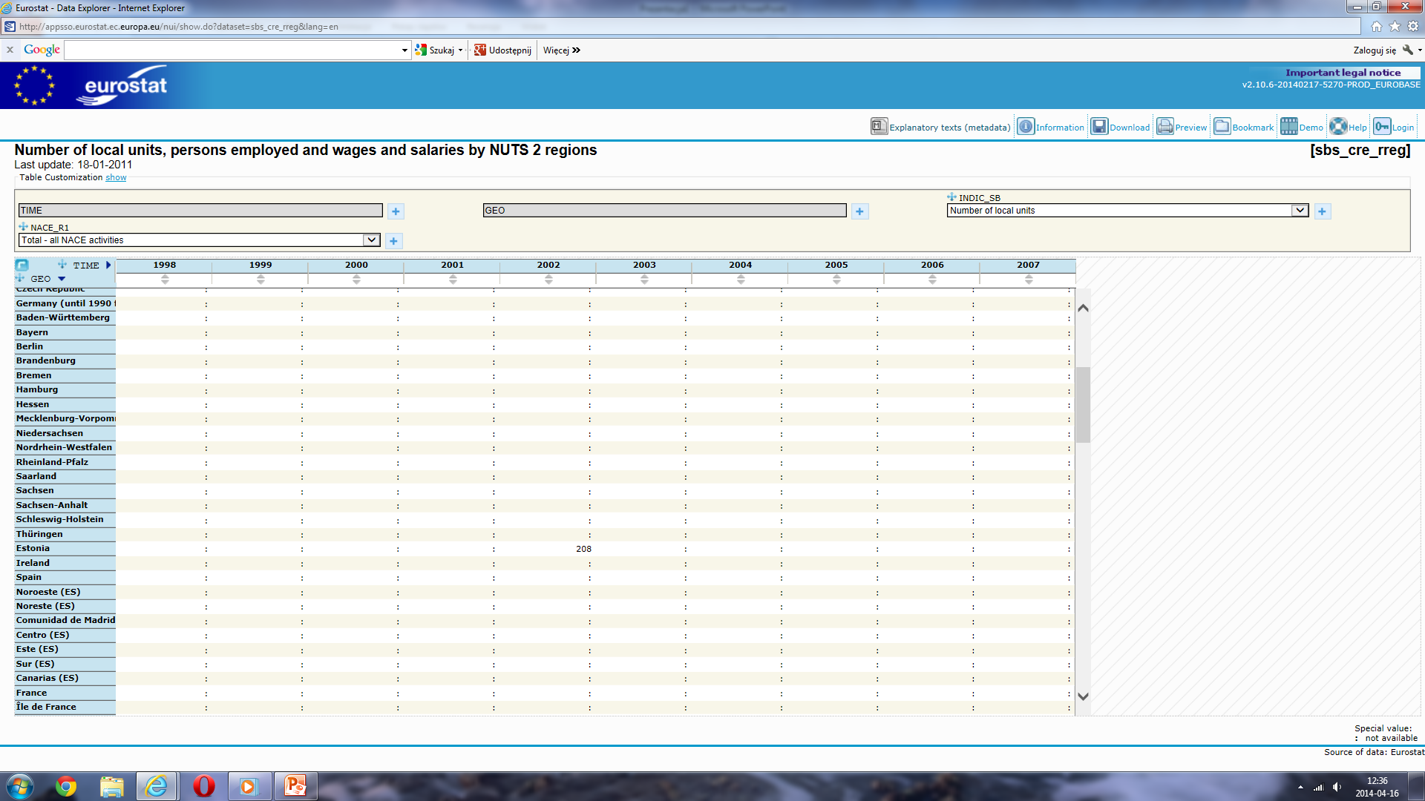

Slide 12
4. In search for the final list of diagnostic variables
Should variables be correlated on uncorrelated?
General strategy: find groups of variables and select one representative from each group
Do not use coefficient of variance to eliminate some variables!
Try to keep balance between sub-criteria

Slide 13
Coefficient of variation
If C_{v}=σ/μ is regarded as a measure of variability, than 1/Cv=μ/σ is a measure of location
C_{v} of transformed variable is different than C_{v} of the original variable (dwellings with water supply – 0,83%; dwellings without water supply – 80,88%)
„Natural” C_{v} of infant mortality is 45-50%
Sokołowski A., Sobolewski M. (2016) O niewłaściwym wykorzystaniu współczynnika zmienności, XXXV Konferencja Naukowa Multivariate Statistical Analysis MSA 2016, Uniwersytet Łódzki

Slide 14
Ordering capability of variables
Variable has good ordering capability if its distribution is „far” from normal distribution and „close” to uniform one
Sample structure is defined as [x_{(i+1)}-x_{(i)}]/[x_{(n)}-x₍₁₎] and than it is compared to the theoretical structure defined by the expected values of order statistics
Sokołowski A. (1985), Wybrane zagadnienia pomiaru i ważenia cech w taksonomii, Zeszyty Naukowe Akademii Ekonomicznej w Krakowie. 1985, nr 203, 41-53

Slide 15
5. Identifying the type of variables
Stimulant or destimulant?
Analysis of the influence of a given variable on the general criterion (e.g. Spendings on social transfers)
Correlation analysis – stimulants should not be significantly and positively correlated with destimulants

Slide 16
BDL (Local Data Base)

Slide 17
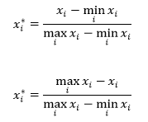
6. Getting rid of measurement units
Standardization / normalization / others
What if all variables are expressed in the same units?
Most popular:
It is better to fix the reference points by yourself

Slide 18
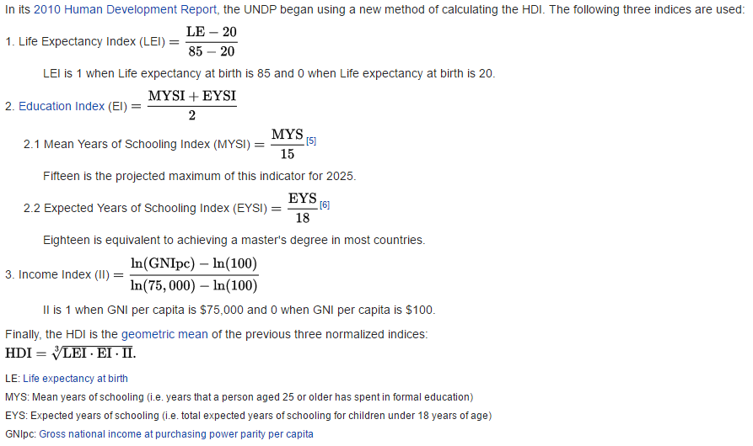
Human Development Index

Slide 19
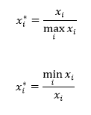
Zero as reference point

Slide 20
7. Weighting system
The best: outside expert choice
The most popular: no weights
The worth: calculating weights from the data
Hidden weights: large differences in number of variables for sub-criteria, skewed distributions, no standardization
Surprising weights

Slide 21
8. Aggregation formula
Most popular: additive
Worth to consider: multiplicative
Worth to develop: robust
Other methods
The result: composite index (not „synthetic”)

Slide 22
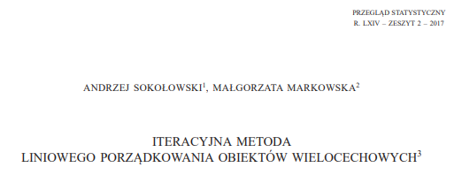
Something new Iterative procedure
Calculate min and max
Find the best object using classical procedure
Assign rank
Eliminate this object from the lot
Go to (1)
Assign last three ranks based on last three objects
Markowska M. (2017), Iteracyjna metoda wzorca i antywzorca rozwoju, XXXVI Konferencja Naukowa Multivariate Statistical Analysis, MSA 2017, Instytut Statystyki i Demografii, Katedra Metod Statystycznych, Uniwersytet Łódzki, Spała, 6-8 listopada 2017 r.

Slide 23
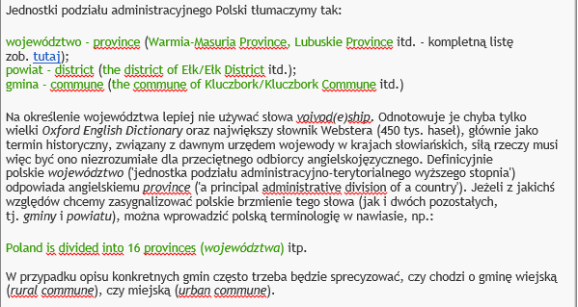
Last but not least

Slide 26
Prezentacja zawierała elementy lokowania produktu

